Slide 1
CGB1201 – JAVA PROGRAMMING FINAL PROJECT REVIEW
Department of CSE(Artificial Intelligence and Machine Learning)
Academic Year: 2024 – 2025 (Odd Semester)
Register Number : 8115U23AM050
Name : SRI HARIKRISHNAN N
Year : 2nd
Semester : 3rd
Department :CSE(AIML)
Date :05.12.2024

Slide 2

Title of the Project
WEATHER FORECASTING SYSTEM

Slide 3
Abstract
The Weather Forecasting System is a comprehensive application designed to provide accurate and real-time weather predictions for users across various locations. Utilizing external weather APIs, the system collects and stores current weather data, enabling users to access current conditions, detailed forecasts, and alerts for severe weather events.

Slide 4
Abstract with CO/PO Mapping
Abstract | CO | POs | PSO
The Weather Forecasting System is a comprehensive application designed to provide accurate and real-time weather predictions for users across various locations. Utilizing external weather APIs, the system collects and stores current weather data, enabling users to access current conditions, detailed forecasts, and alerts for severe weather events. | CO2 | PO2 | PSO2

Slide 5
Introduction
A Weather Forecasting System is designed to predict and provide real-time weather information based on data from various sources, such as weather satellites, weather stations, and meteorological services.
Weather forecasting systems have become essential tools in various fields, including agriculture, transportation, emergency services, and everyday life. These systems rely on vast amounts of data that are collected through advanced technologies, such as radar, satellites, and weather sensors.

Slide 6
Java Programming - Concepts Used
Object-Oriented Programming (OOP)
Define models like weather data, user, alert. Create a base class for common attributes and methods, allowing other classes to extend it.
ExceptionHandling
Use try-catch blocks to handle potential errors, such as API call failures or database connection issues, ensuring the application remains robust.
Data Structures
Utilize lists(eg.ArrayList),maps(eg.HashMap),and sets(eg.HashSet)for managing collections of data such as user preferences and weather conditions.

Slide 7
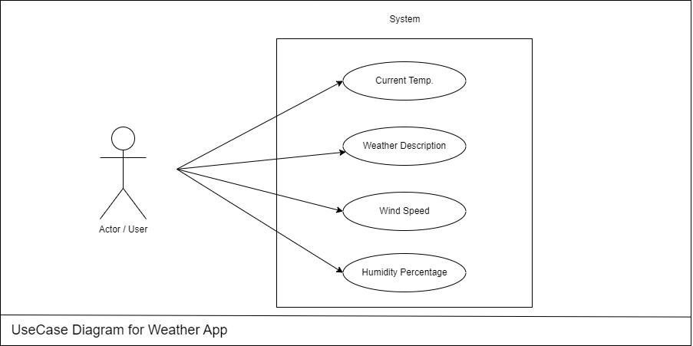
Proposed Architecture

Slide 8
Proposed Architecture - Description
User: The user inputs the name of a city they want to check the weather for.
API: The system sends the city name to an external weather API (like OpenWeatherMap). The API is responsible for retrieving the weather details based on the city name provided.

Slide 9
Proposed Architecture - Description (Cont..)
Weather DB: The API queries a database of weather information to fetch the required data (e.g., temperature, humidity, and weather conditions). This database stores all the historical and real-time weather data for cities worldwide.
Output: After retrieving the data, the system displays the weather details to the user, such as current temperature, humidity, and weather conditions like sunny, rainy, or cloudy.

Slide 10
List of Modules
getTemperature Module
getWeatherCondition Module
getHumidity Module
DisplayWeather Module
User Interface Module

Slide 11
Module Description
Temperature Generator (getTemperature):
Generates random temperatures ranging from -10°C to 40°C using Random class.
Provides dynamic weather variability for the simulation.
Weather Condition Generator (getWeatherCondition):
Randomly selects a weather condition from predefined options (e.g., Sunny, Rainy, Snowy).
Simulates realistic weather diversity using an array of conditions

Slide 12
Module Description (Cont..)
Humidity Generator (getHumidity):
Generates random humidity levels between 20% and 100% to represent different atmospheric conditions.
Display Weather (displayWeather):
Combines data from the generators to display a forecast for the user-specified city.
Formats the output to include city name, temperature, weather condition, and humidity.
User Interaction:
Accepts city name input from the user via a Scanner for personalized weather forecasting.
Ensures a dynamic experience as output varies with every execution.

Slide 13
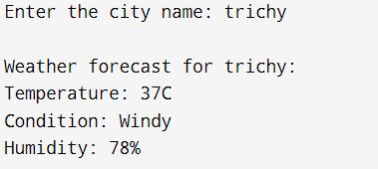
Results and Discussion

Slide 14
Conclusion
The Weather Forecasting System represents a comprehensive approach to providing accurate and real-time weather data to users and industries. By leveraging modern Java concepts and frameworks, the system is designed to be modular, scalable, and maintainable.

Slide 15
THANK YOU

